Slide 1
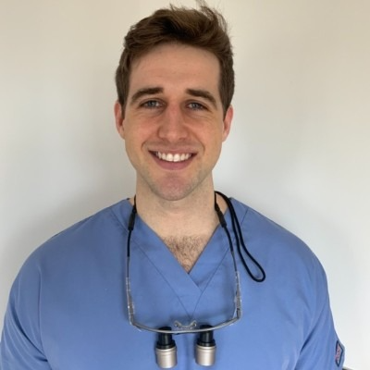
Session Title | Overview of Youth Violence
Author name | Dr Declan Hughes
Author email address | Declan.
Author address and tel. No. | Oral and Maxillofacial surgery department, Day surgery building, Kings College hospital, Denmark Hill, London SE5 9RS
Author biography and photo | Declan Hughes graduated from Cardiff University Dental school with Honours in 2017 and obtained Membership of Faculty of Dental Surgeons with Royal College of Surgeons, Edinburgh in 2019. He has worked in Oral and Maxillofacial surgery units across London including Queen Mary Hospital Sidcup, Kings College Hospital, Whipps Cross Hospital and the Royal London Hospital. He is currently within his final year of the accelerated medical degree at Queen Mary University of London to pursue a career in Oral and Maxillofacial surgery.

Slide 2
Session Overview (Page 1)
Description
This session defines what youth violence is, provides an overview of the scale of the issue, and explores why this topic has become such a public health challenge. Throughout this session we will explore identification of patients at risk, how to effectively communicate and how to collaborate with the wider team to provide holistic care and create longstanding change.
Session Title
Author Dr Declan Hughes
Duration 20 minutes

Slide 3
Session Introduction (Page 2)
Learning Objectives
By the end of this session you should be able to:
Describe and define what youth violence is.
List the types of violence and exploitation that young persons may be abused by.
Identify patients at risk of youth violence and criminal exploitation.
Explain communication strategies to open a dialogue and initiate behavioural change.
Understand how clinicians and the wider team can help interrupt this cycle of violence.
Prerequisites
No pre-requisite knowledge is required

Slide 4
Introduction (Page 3)
Youth violence is a devastating and expansive public health issue. The effects of youth violence can cause harrowing morbidity and mortality with long term effects to individuals, family, community, and society. Recognising youth violence as a public health challenge is key to effectively address key issues, risk factors, and employ preventative strategies.
The gravity of youth violence is evident in the media whereby the frequency of youths having lost their life from violence and knife crime is all too common and tragic. As clinicians on the frontline, we must do what we can to address and and prevent this issue. This session will provide an overview of youth violence highlighting key topics and its challenges as a public health issue.

Slide 5
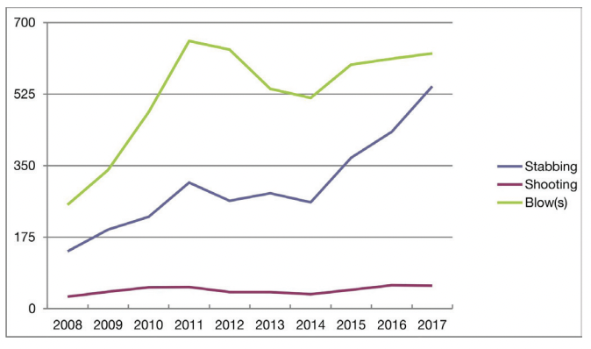
Page Type: Optional Review Question Page Page Title: Prevalence of youth violence
Question: In 2018/2019 how many emergency hospital admissions amongst 10-19 year olds were for assault with a sharp object?
314
565
899
1,012
Answer: D
Explanation: Admissions for serious youth violence are rising with assault with a sharp object rising almost 60% since 2012/13 in this age group.
Reference: Hospital admissions for assault with a sharp object. NHS Digital. (2019)
Fig 1 Annual trauma cases due to presumed violence (stabbing, shooting, blows), per year, 10–24 years, reported to TARN (Trauma Audit Research Network), England, 2008–2017.

Slide 6
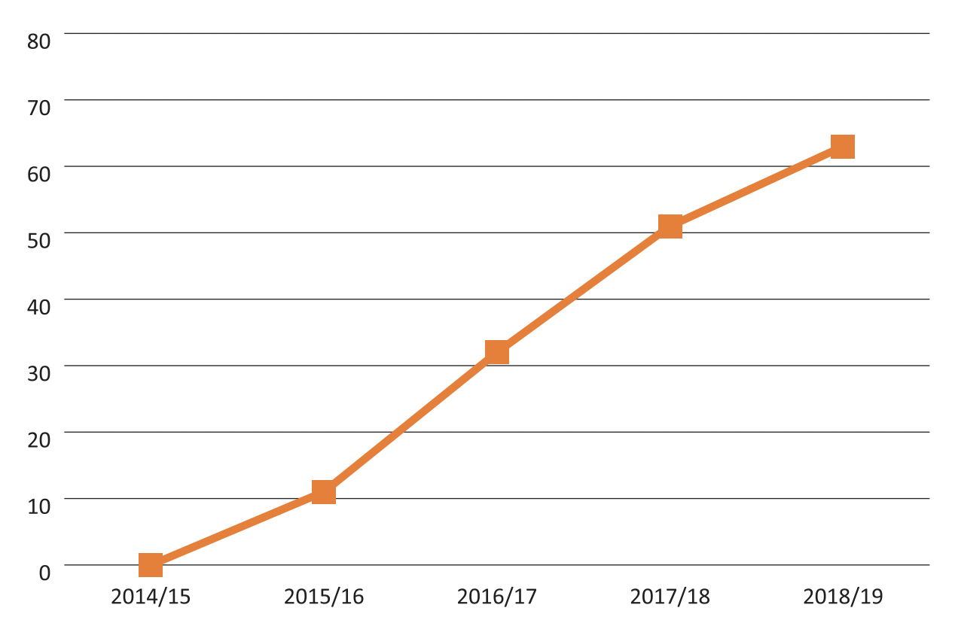
Page Type: Optional Review Question Page Page Title: Cost of youth violence
Question: In 2018/2019 what is the total economic and social cost of serious youth violence across England and Wales?
£700 million
£850 million
£1.3 billion
£1.5 billlion
Answer: C
Explanation: In 2018/19, the total economic and social cost of serious youth violence across England and Wales £1.3 billion when accounting for non-fatal violent incidents not reported to the police. This equates to a rise in cost of >50% compared to 2014/15. There is a direct correlation between the growth in violent youth cases in terms of both cost and magnitude.
Reference: “Youth Violence Commission Final Report” Irwin-Rogers et al. (2020).
Fig 1 Percentage increases – year on year – in the total number of serious youth violent offences using the data from the British Crime Survey data and the PRC data (with 2014/15 as base year).

Slide 7
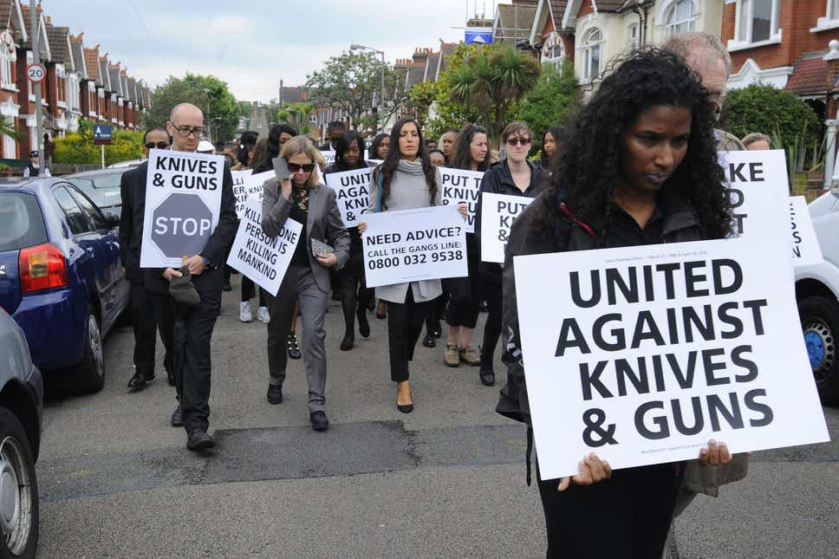
Page Type: Learning Objective 1 Presentation Page Page Title: Background of youth violence
Youth violence is not a new problem however our approach to it is changing. Previously considered a crime and social issue, new government and institutional reports are recognising that this is a public health issue requiring significant upskilling and investment to address. Youth violence not only harms its victims but also deeply impacts families, friends and communities creating scars that run more than skin deep.
As frontline clinicians, it is essential that we recognise and understand the issues faced by our patients who are trapped in this cycle of violence so that we can provide ongoing support and empower them to improve their lives and communities.
Fig 1 Picture of protestors campaigning against youth violence

Slide 8
Page Type: Learning Objective 1 Presentation Page Page Title: Youth violence definitions
Hover over each label to learn more about important definitions in youth violence
Youth violence
Youth violence is the intentional use of physical force or power to threaten or harm others by young people ages 10-24
Criminal child exploitation
Another person or persons manipulate, deceive, coerce, or control the person to undertake activity which constitutes a criminal offence where the person is under the age of 18.
Adversity related injury Adversity related injury are those comprising of non-mutually exclusive groups of self-inflicted, drug-related or alcohol-related, or violent injury, irrespective of whether the injury was also accident related
Adverse childhood experiences
Adverse childhood experiences are “highly stressful, and potentially traumatic, events or situations that occur during childhood and/or adolescence. They can be a single event, or prolonged threats to, and breaches of, the young person’s safety, security, trust, or bodily integrity.
Contextual safeguarding
Contextual safeguarding recognises the impact of the public/social context on young people’s lives, and consequently their safety. Contextual safeguarding seeks to identify and respond to harm and abuse posed to young people outside their home, either from adults or other young people.
Gang
A relatively durable, predominantly street-based group of young people, who see themselves (and are seen by others) as a discernible group. Engage in a range of criminal activity and violence. Identify with or lay claim over territory
Notes:
*****On this page, 4 buttons and when you hover them the text will appear****

Slide 9
Page Type: Learning Objective 1 Presentation Page Page Title: Involvement in youth violence
Involvement in youth violence relates to a complex interplay of multiple factors at a personal, family and community level. Factors such as socioeconomic deprivation, BAME background, educational failure, mental health issues, poor family stability, urban residence and doing poorly in “the postcode lottery’ can all significantly impact risk of youth violence.
The disparity between the wealthiest and poorest of our society has hit an all-time high and this has significant implications on health inequities such as youth violence. Serious violence is strongly correlated to deprivation and there is a sixfold difference in hospital admission rates between the poorest and wealthiest quintiles of our society.
¹ Osidipe T, Palmer S. Serious Youth Violence in Britain: Is the Public Health Approach the Solution? British Society of Criminology Newsletter. 2018:22.
² Bellis MA, et al. Contribution of violence to health inequalities in England: demographics and trends in emergency hospital admissions for assault. Journal of Epidemiology & Community Health. 2008;62(12):1064-71.

Slide 10
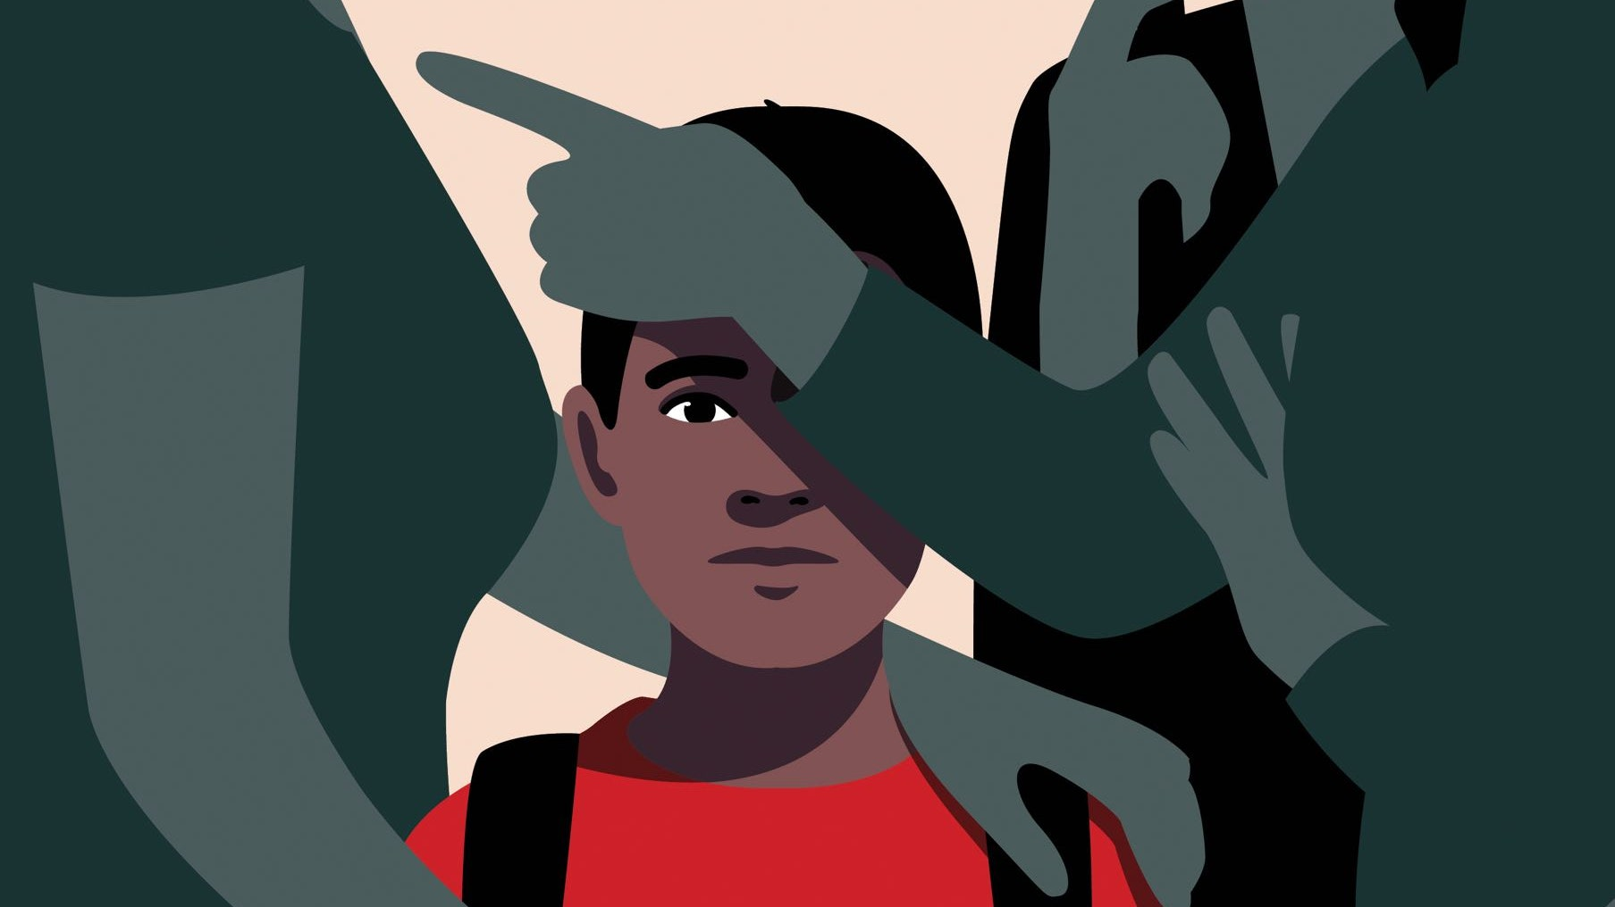
Page Type: Learning Objective 1 Presentation Page Page Title: Aetiology of youth violence
While demographics play a significant role in placing an individual at risk of youth violence there is strong evidence that certain events or social acts throughout a person’s life can drastically increase risk of violence.
Adverse childhood experiences comprise a broad range of potentially traumatic events occurring during childhood or adolescence These events are subdivided into 3 major groups of abuse, household challenges, or neglect. These toxic events cause unmitigated stress leading to maladaptive coping strategies that compromises health over a lifespan. There is a graded dose-response relationship between the severity and amount of adverse childhood experiences and poor health and social outcomes.
¹ Smith L. Adverse childhood experiences (ACEs): Interventions in education. Scotland: IRSS Recuperado de www iriss org uk/resources/ess-outlines. 2018.

Slide 11
Page Type: Learning Objective 1 Presentation Page Page Title: Types of adverse childhood experience
In regard to violence, those with >4 adverse childhood experiences compared to those with none are:
14 times more likely to have been a victim of violence
15 times more likely to have committed violence against another person
20 times more likely to have been incarcerated
Criminal household member
Drug use
Alcohol abuse
Poor family stability
Mental illness in household
Sexual violence
Financial stress
Foster care
Emotional, Physical, or Sexual Abuse
Chronic disease
Fig 1
¹ Bellis MA, Ashton K, Hughes K, Ford K, Bishop J, Paranjothy S. Adverse childhood experiences and their impact on health-harming behaviours in the Welsh adult population. In: Wales PH, editor.: Public Health Wales NHS Trust; 2015.
Notes:
Alcoholism and alcohol abuse, Chronic obstructive pulmonary disease, Depression, Foetal death, Health-related quality of life, Illicit drug use, Ischemic heart disease, Liver disease, Poor work performance, Financial stress, Risk for intimate partner violence, Multiple sexual partners, Sexually transmitted diseases, Smoking, Suicide attempts, Unintended pregnancies, Early initiation of smoking, Early initiation of sexual activity, Adolescent pregnancy, Risk for sexual violence, Poor academic achievement

Slide 12
Page Type: Learning Objective 2 Presentation Page Page Title: Girls and youth violence
Youth violence amongst women and young girls is an under-reported and under-explored topic. Many policies fail to recognise or acknowledge serious youth and gang violence amongst young women and girls. Young women are less likely to report crimes and more likely to be stigmatised in our society at large. About one in every 20 women in England has experienced extensive physical and sexual violence and abuse across their life course, compared to one in every 100 men. ¹
Sexual violence and exploitation are significant weapons used by criminal gangs and organisations to coerce and control female victims into supporting gang activities. Young women and girls are exploited through threats of violence or blackmail to carry out criminal or sexual activities. All Healthcare professionals must be able to identify the presentation of abuse and be able to address any issues sensitively while working with the wider team to support victims. Most authorities have a Violence Against Woman Group (VAWG) which can support victims following abuse. Further research and recognition is needed to explore the effects of youth violence on young woman, particularly those groups who are most marginalised within our society.
¹ Hidden Hurt: Violence, Abuse and Disadvantage in the lives of women Sarah Scott and Sally McManus. 2016.

Slide 13
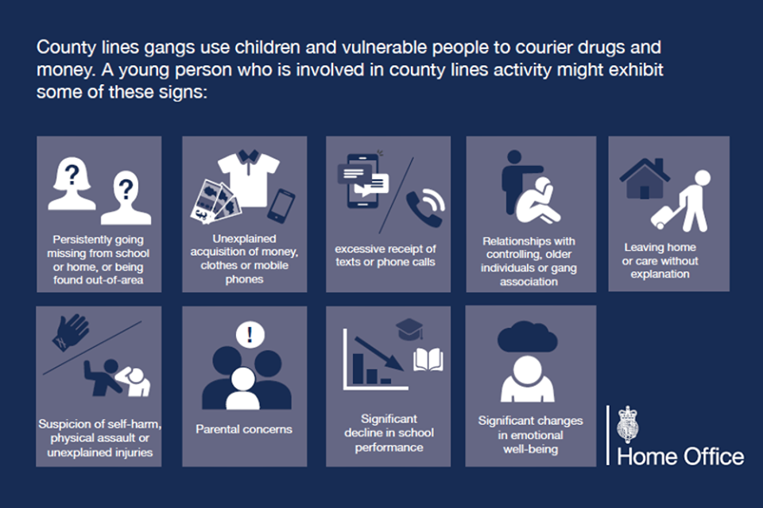
Page Type: Learning Objective 2 Presentation Page Page Title: Child criminal/sexual exploitation
Vulnerable young persons can be manipulated and coerced into joining gangs and committing crimes. Once indebted to the gang they can be manipulated with threats of physical or sexual violence to act within a system of criminal activity.
County lines and exploiting vulnerable young adolescents distribute narcotics to 81% of the 43 police areas in England. ¹
Children in care, with mental health issues or those on the fringes of society are the most easily exploited and abused by criminal networks. Once entrenched in gang activity, victims may feel unsafe outside the network due to rival gang activity, further preventing opportunity and raising risk of violence.
¹ National crime agency. County Lines Violence, Exploitation & Drug Supply. 2017

Slide 14
Page Type: Learning Objective 2 Presentation Page Page Title: County lines
One such system of child criminal exploitation which has received notable media attention is “County lines”. This form of criminal activity exploits young persons to carry and sell drugs across the country, imposing high levels of physical and sexual violence for failure to comply. The evolving expansive nature of crime and gang behaviour from traditionally urban centres to rural environments seen with “county lines” further reinforces the need for national education in violence intervention.
¹ Haringey Council. Young People at Risk Strategy. In: Haringey Council, editor. London: 2019; 2019.

Slide 15
Page Type: Learning Objective 3 Presentation Page Page Title: Frontline healthcare professionals and youth violence
As frontline workers who deal with victims of youth violence every day, it is essential that we make every contact count. Hospital attendances due to violence-related-injuries act as a moment of crisis for the patient where they are more likely to discuss issues beyond their immediate physical injury.
These “teachable moments’ represent an important opportunity for clinicians and support staff to engage and positively support change. All frontline staff can and should identify victims to build trust, reduce re-attendance and positively impact quality of life. It is imperative that we all act to recognise and address these issues.
¹ “Protecting people, promoting health: A public health approach to violence prevention for England” Bellis et al. (2012)
² ”Violence Reduction Units (VRUs) in focus”. Association of police and crime commissioners. (2020).
³ “Youth Violence Commission Final Report” Irwin-Rogers et al. (2020).
Fig 1 Figure showing covers of national commissioned reports focusing on violence reduction and youth violence.

Slide 16
Page Type: Learning Objective 4 Presentation Page Page Title: Recognising and overcoming barriers
Victims of youth violence presenting to emergency services will normally be in a state of emotional shock with some level of physical and psychological harm in a chaotic environment with unfamiliar authority figures.
Victims may not recognise their situation or lack the necessary communication skills to effectively express recent events. Furthermore, victims may have a deep-seated mistrust of institutional powers or fear retribution attacks or further abuse. All these conditions raise tensions within the clinical environment and act as significant barriers to engagement.
The first step to helping victims of youth violence is recognising those in crisis and actively trying to understand their circumstances and journey to this point.
Fragmented memory
Aggression
Guilt
PTSD
hypersensitivity
Anxiety
Blame
Depression
Fig 1 Features of the acute stress response

Slide 17
Page Type: Learning Objective 4 Presentation Page Page Title: Setting the stage
Effective communication begins at the outset, a loud chaotic open ED bay not only serves as a distraction but heightens anxiety preventing effective communication. Ideally a comfortable, quiet, and private room where both the clinician and victim can speak sitting down at the same level without any barriers to communication.
Ensuring open body-language and maintaining an unbiased communication style free of belief systems, assumptions or judgements are paramount to developing rapport and building a trusting professional relationship. Patients should be informed that any information exchanged is confidential unless they or other individuals are placed at risk of harm.
Ask the adolescent their information first and ask them to introduce the others in the room – lets the adolescent know they are the focus from the outset. Let the patient know that there will be some potentially sensitive questions and they may find it easier to talk alone for a short period.

Slide 18
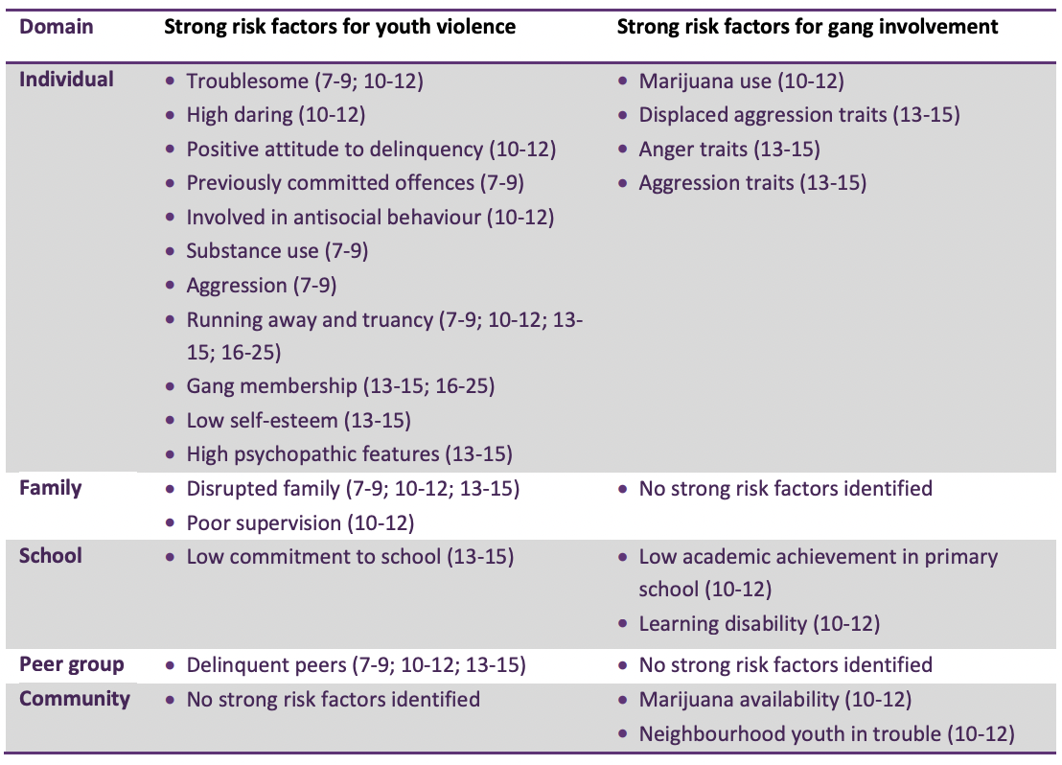
Page Type: Learning Objective 3 Presentation Page Page Title: Risk assessment
In order to effectively tackle youth violence, clinicians must be aware of contributing risk factors and be able to identify suspicious cases. Children and young persons involved or at risk of violence may be afraid or lack the ability to effectively communicate their circumstances and their injuries. Therefore, it is essential that all healthcare professionals can identify patterns of violence and work with local agencies to support victims .¹
Waddell S. Preventing gang and youth violence: Spotting signals of risk and supporting children and young people. Early Intervention Foundation; 2015.
Fig 1 Risk factors for youth violence and gang involvement

Slide 19
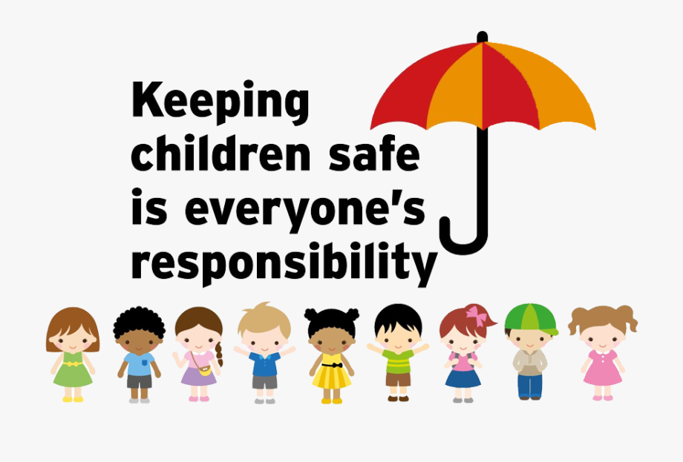
Page Type: Learning Objective 3 Presentation Page Page Title: Recognising signs and symptoms of abuse
Identifying behaviours and features of possible child criminal or sexual exploitation must always be at the forefront when evaluating traumatic injuries. Violent behaviour, criminal activity and weapon use are not always immediately obvious and not often revealed during a simple exam and history. Therefore, following stabilisation it is imperative that we look outside of the initial injury and holistically assess the patient for other signs of abuse.
Once specific concerns have been identified, clinicians must go on to explore these issues within the patient history without prejudice, assumptions, or bias.

Slide 20
Page Type: Learning Objective 4 Presentation Page Page Title: History-taking: Opening a dialogue
Opening a non-judgmental bidirectional communication style which empowers the patient to give their story is key to exploring sensitive issues later on.
Using simple techniques such as open-ended questions and pausing after statements to encourage further disclosures are incredibly valuable.
Avoid pitfalls such as victim blaming or making assumptions about the patient. Maintain patient trust by involving them in all discussions and care planning.
Let them know you are concerned:
What has happened is not ok.
I am worried about you.
How are you feeling?
Who do you live with? Do you have somewhere safe to go when you leave the hospital?
Is there anybody or place that makes you feels unsafe?
Do you feel safe in your area/at home/at school?
Have you ever felt pressure to do things that you didn’t want to do?
Have you been hurt or threatened?
Fig. 1 Examples of good open questions to facilitate communication

Slide 21
Page Type: Learning Objective 4 Presentation Page Page Title: HEADSSS psychosocial interview framework
Recording a standard history is likely to miss out on many key issues pertinent to youth violence. Use of a HEADSSS structure can ensure key topics are covered while using a reliable structure to facilitate communication in a respectful manner. Many threats to health occurring during adolescence are related to physical and social exploration. Utilising a psychosocial interview framework allows clinicians to more effectively assess for risk factors which may contribute to youth violence.
¹ Klein DA, Goldenring JM, Adelman WP. HEEADSSS 3.0: the psychosocial interview for adolescents updated for a new century fueled by media.
Home Education, Employment, Eating
Activities Drugs
Sexuality
Suicide
Safety
Fig 1 Explaining components of the HEADSSS psychosocial interview framework

Slide 22
Page Type: Learning Objective 4 Presentation Page Page Title: Being curious – asking questions?
Recording a universal adolescent history must be uniquely adapted for each individual case based on the individual and circumstances. Easing patients into questions via an indirect route can reduce judgment, stigma and anxiety.
Improving opening questions
Are things ok with Mum and Dad at home? | Where do you stay, who else lives there? (Avoids assumptions)
Do you do any activities? | What do you and your friends do for fun? Do you practice any spiritual activities? (Open-ended, develops dialogue, understand value system)
Do you use drugs or alcohol? | Do many people you know use drugs or alcohol for fun? Do you ever try these things? (Less personal, ease into discussion)
Do you have sex? | Have you ever been in a romantic relationship? Was that something positive or did you ever feel pressured? (Less intrusive, explores exploitation)
Are you in a gang? | Do you feel safe in your area? Are there neighborhoods you avoid? Why? (Less intrusive, empowers individual to disclose)
Have you ever been assaulted? | Is there a lot of violence in your neighborhood? Have you ever been seriously injured? Have you ever felt the need to carry something for protection? (Explore
Fig 1 Examples of poor and improved opening questions

Slide 23
Page Type: Learning Objective 4 Presentation Page Page Title: Trauma informed care
Trauma informed care aims to provide healthcare where the patient feels safe, empowered and trusting of the professionals collaborating in their care¹. Good practice avoids behaviours or dynamics which are reminiscent of the original abuse such as: shaming, belittling, criminalisation, manipulation, victim-blaming etc.
Traumatic experiences induce acute stress responses inhibiting our ability to provide an accurate history, communicate or work with healthcare professionals. Healthcare professionals should be able to identify possible sources of institutional trauma, and work with survivors collaboratively to avoid power imbalances or any potentials trauma triggers.
Through respectful practice and a trauma-led approach we can support victims to create persistent and positive change.
¹ Sweeney A, Clement S, Filson B, Kennedy A. Trauma-informed mental healthcare in the UK: what is it and how can we further its development?. Mental Health Review Journal. 2016 Sep 12.

Slide 24
Page Type: Learning Objective 4 Presentation Page Page Title: Power of Language
Language is an extremely powerful tool or barrier in providing care to victims of abuse.
Clinician to clinician
As healthcare professionals we must recognise this and avoid creating barriers which may bias other professionals or disenfranchise victims from our service. Labels such as “aggressive”, “resilient” or “promiscuous” follow patients create a narrative with consequences for the care they receive going forward. We must also be aware that many cases of youth violence may involve criminal prosecution with patients seeking access to medical notes.
Clinician to victim
In order to support and empower victims we must first create trusting relationships with patients at first contact. Language should be clear, accessible, and age-appropriate to avoid confusion or mistrust. The language used by professionals can often impact the way the victim feels about themselves. Therefore, it is important professionals avoid victim blaming and reframe language to support and empower patients so that they may have a positive experience of our service.
Trauma informed language
What’s wrong with you? | What happened to you?
You should be over this by now! | It’s ok to feel these feelings. If you’re ready, we can talk about ways I can help you?
“Difficult to engage” or “poor historian” | I was not able to engage them
Putting themselves at risk | Vulnerable patient susceptible to exploitation, harm and abuse
Fig 1 Examples of harmful statements reframed which can affect relationships and perception of the victim

Slide 25
Page Type: Learning Objective 4 Presentation Page Page Title: Teachable moments
Following a traumatic event, there is a window of opportunity whereby initiating change becomes most possible. This moment of crisis and introspection allows healthcare professionals and youth workers to employ a technique known as “teachable moments”. In the aftermath of a violent event professionals initiate a dialogue with the victims while they are still present in A&E. During this interaction they go through events and wider determinants of health to establish goals and develop an action plan with the support of local services.
Through integration with the wider team and support from youth workers we can address risk factors, envision a better future and create the change necessary for a life free from trauma,
¹ Wortley E, Hagell A. Young victims of youth violence: using youth workers in the emergency department to facilitate ‘teachable moments’ and to improve access to services. Archives of Disease in Childhood-Education and Practice. 2021 Feb 1;106(1):53-9.
Precontemplation
Patient engaging in behaviours at risk for violence.
Contemplation
Patient reflects on seriousness of incident
Teachable moments intervention employed in A&E
Preparation
Maintenance
Action
Pre-traumatic incident.
Support from health and care services.
Patient makes positive life changes
Youth services to establish trusting partnership.
Development of action plan.
Further development of self-efficacy and positive growth
Freedom from trauma
Improved quality of life
Violent incident – Attendance at trauma centre
Fig 1 Employment of teachable moments in transtheoretical model of change

Slide 26
Page Type: Learning Objective 4 Presentation Page Page Title: Involving the wider team
Once youth violence concerns have been identified and raised. Information must be shared with local services, consent should be sought, but this may be overridden if there is safeguarding concerns.
Dealing with complex social issues such as youth violence requires multidisciplinary input from both health and care services. A combined multi-agency approach is required to improve wellbeing, prevent further harm and tackle inequalities. Local services, resources and policies will be different between departments, hospitals and trusts so healthcare professionals must be aware of their local procedures.
¹ Blackburn S, Hudspeth I, Bramble A. Breaking the cycle of youth violence. In: Association LG, editor. London. 2019.
Fig 1 Picture of teamwork

Slide 27
Page Type: Learning Objective 4 Presentation Page Page Title: In-hospital violence reduction services
There are a number of in-hospital violence reduction services which can provide immediate support in the aftermath of a traumatic event.
Redthread
St Giles trust
Oasis
MAV navigator programme
These organisations exist to support victims of violent trauma, provide contextual safeguarding and co-ordinate with care services.
Redthread https://www.redthread.org.uk/
MAV Navigator Programme https://www.mav.scot/
Oasis charitable trust https://www.oasisuk.org/
St Giles Trust https://www.stgilestrust.org.uk/
Fig 1 Logos for in-house violence reduction services

Slide 28
Page Type: Learning Objective 4 Presentation Page Page Title: Case study – Mark
Mark is a 15-year-old male who has presented to the A&E on a Friday evening with 2 of his friends with a cut across his face.
He reveals he was in a fight and was cut by someone he had an argument with online.
He has not reported it to the police as “won’t do anything anyway”.
The doctor reminds Mark he should be more careful and that getting into fights is stupid.
As he is being sutured, his 2 friends snapchat and laugh about the incident.
He declines further support and self-discharges from A&E. No further action is taken by healthcare staff.
Fig 1 Textbox asking the reader how this consultation could be improved

Slide 29
Page Type: Learning Objective 4 Presentation Page Page Title: Case study
Setting the stage
Consider safety and environment, are these friends looking out for Mark’s his best interest? Sharing information of events on social media could place Mark at risk of further violence and abuse.
Mark should have been separated from friends and taken somewhere quiet for the consultation. Marks “friends” should have been asked to immediately stop sharing information regarding the events.
Ensure confidentiality unless patient or others at risk.
History-taking and risk assessment
Use of non-judgemental language, use of open-ended questions.
The history requires more detail: where and when did this happen, what events led to this fight, what type of weapon was used.
Use of HEADSSS framework: Mark reveals he has trouble at home and school. He stays at friends houses now. He sells drugs to earn money to support himself. This is not the first time he has been attacked. He does not feel safe outside his neighbourhood anymore and fears the next attack will be worse.

Slide 30
Page Type: Learning Objective 4 Presentation Page Page Title: Case study
Communication
Teachable moments: The doctor informs Mark “I am worried about you, what has happened is not ok.” “If you’re happy to talk about it, can I let you know of some ways I can help”
Help is offered and explained to Mark so he understands who and how he can be supported
Mark consents for safeguarding measures and referrals to be put in place.
Working with the wider team
The on-call paediatric consultant is informed who raises the issue with the trust safeguarding children team.
Further safeguarding concerns are raised regarding his “friends” who were uploading the events of his attack onto social media.
A referral to the in-house violence reduction services is made and a youth worker is appointed to Mark to act as his advocate, assist with basic needs and provide long term support.
Social services are informed and reveal Mark is known to them due to abuse at home and being affiliated with a local gang.
The police were informed as Mark was judged at being at risk for further serious harm.
A professionals meeting is held, and an action plan was put in place.

Slide 31
Self Assessment
A series of self-assessments will follow this page.
[Type image name here]
[Type a brief description of image here]
Question_mark.jpg

Slide 32
Page Type: Learning Objective 1 Question Page Page Title: Normal reactions to traumatic experiences
Which of the following is NOT part of the normal stress response following a traumatic experience
a) Fragmented memory
b) Aggression
c) Poor concentration
d) Sleepiness
e) Hypersensitivity to danger
Answer (d)

Slide 33
Page Type: Learning Objective 2 Question Page Page Title: How to manage reports of violence
If a young person reports they have gotten into a fight and are afraid of leaving home for fear of further attacks
a) Take history, treat injuries and discharge
b) Tell them to toughen up
c) Ask them to make an appointment with their GP
d) Raise safeguarding concerns with your line manager
Answer (d)

Slide 34
Page Type: Learning Objective 3 Question Page Page Title: Who should manage youth violence?
Youth violence should be managed by which agencies?
a) Police and the justice system
b) Healthcare services and the NHS
c) Care and social services
d) Local and national government
e) All of the above
Answer (e)

Slide 35
Page Type: Learning Objective 4 Question Page Page Title: Components of the HEADSSS psychosocial interview
Which of the following is NOT a component of the HEADSSS psychosocial interview framework?
a) Safety
b) Suicide
c) Exercise
d) Home
e) Drugs
Answer (c)

Slide 36
Page Type: Learning Objective 4 Question Page Page Title: Risk factors to identify exploitation
Which of the following risk factors do NOT indicate potential exploitation
a) Good school attendance
b) Unexplained money/gifts/multiple phones
c) Multiple traumatic hospital attendances
d) Older romantic partner
e) Drug or alcohol addiction
Answer (a)

Slide 37
Session Key Points
The determinants of youth violence are complex, predominantly affecting the most disadvantaged
Healthcare practitioners should be vigilant for young persons at risk of abuse and exploitation.
Effective communication and empathy empowers victims to disclose the events and circumstances leading up to a traumatic event.
Clinicians must be aware of local policies and support services. Management of youth violence requires a multi-agency approach to address health, social and safety concerns.

Slide 38
Session Summary
Learning Objectives
Having completed this session you should now be able to:
Describe and define what youth violence is.
List the types of violence and exploitation that young persons may be abused by.
Identify patients at risk of youth violence and criminal exploitation.
Explain communication strategies to open a dialogue and initiate behavioural change.
Understand how clinicians and the wider team can help interrupt this cycle of violence.
Further Reading
“Protecting people, promoting health: A public health approach to violence prevention for England” Bellis et al. (2012)
“Youth Violence Commission Final Report” Irwin-Rogers et al. (2020).
“Preventing gang and youth violence: Spotting signals of risk and supporting children and young people” Early Intervention Foundation. (2015).

Slide 39
Acknowledgements
Enter any organisations/bodies/individuals (in addition to copyright holder) who you wish to acknowledge:
Name: Professor Kathleen Fan
Description: Prof. Fan was the corresponding author for this project, supervising and providing guidance throughout.
Name: Cham Harrak
Description: Cham Harrak is a youth worker for Redthread who supported this work by providing valuable feedback.

